Slide 1
Bracketing Method (Root-Finding)
Numerical Methods – Concept, Types & Example

Slide 2
What is the Bracketing Method?
• Numerical technique for finding roots of equations.
• Based on Intermediate Value Theorem:
If f(a)·f(b) < 0, a root exists in [a, b]
• Requires a function to be continuous in the interval.

Slide 3
Types of Bracketing Methods
1. Bisection Method:
• Splits interval and chooses half with sign change.
2. False Position (Regula Falsi):
• Uses secant line between f(a) and f(b) to estimate root.
3. Brent’s Method:
• Combines bisection, secant, and interpolation for faster convergence.

Slide 4
Steps of Bracketing Method
1. Choose a and b such that f(a)·f(b) < 0
2. Compute root approximation (midpoint or secant line)
3. Check for convergence (|f(x)| < tolerance)
4. Narrow the interval and repeat

Slide 5
Example: f(x) = x³ - 4x + 1
Try interval a = 0, b = 1
f(0) = 1, f(1) = -2 → Signs opposite
→ Root lies between [0, 1]
→ Apply bisection or false position method

Slide 6
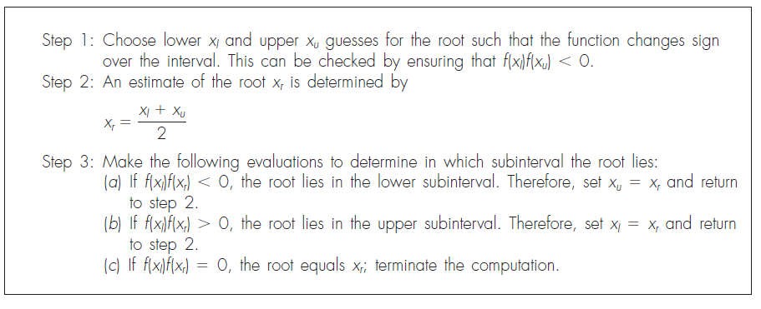
Bisection Method

Slide 7
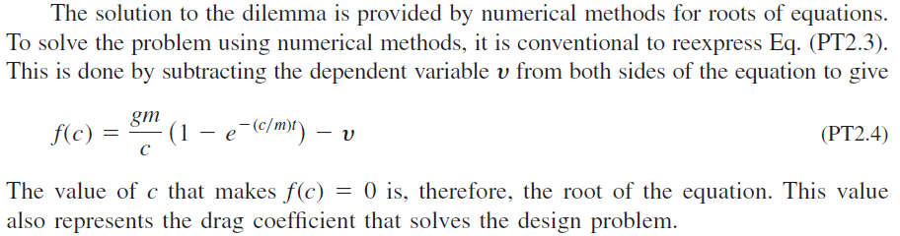

EXAMPLE 5.3 Bisection
Determine the drag coefficient c needed for a parachutist of mass m = 68.1 kg to have a velocity of 40 m/s after freefalling for time t = 10 s. Note: The acceleration due to gravity is 9.81 m/s2.

Slide 8
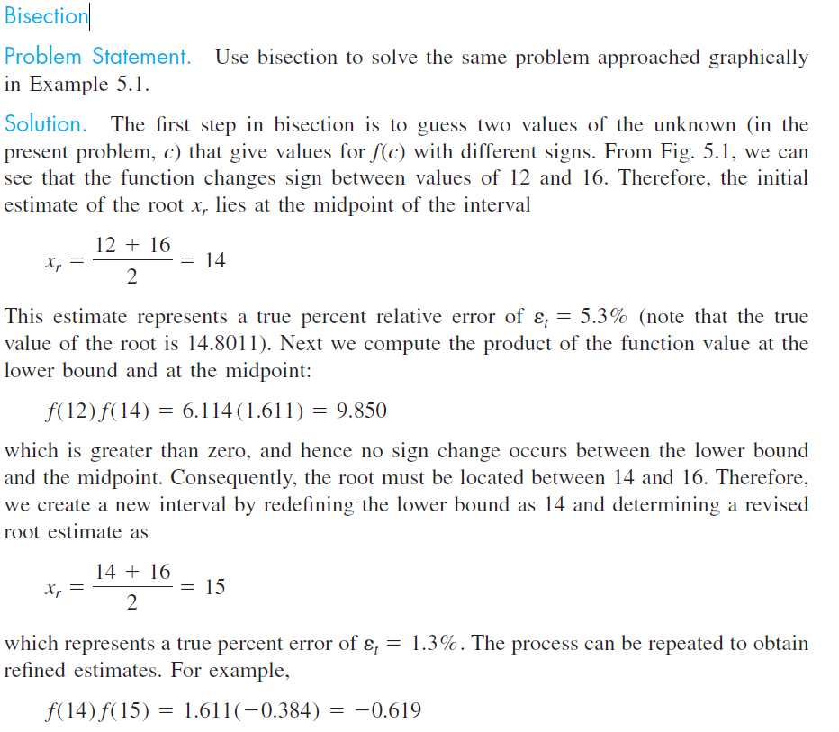
EXAMPLE 5.3 Bisection

Slide 9
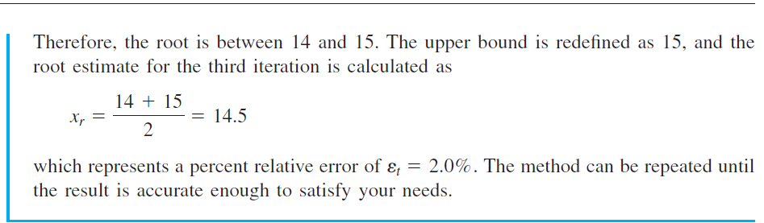
EXAMPLE 5.3 Bisection

Slide 10
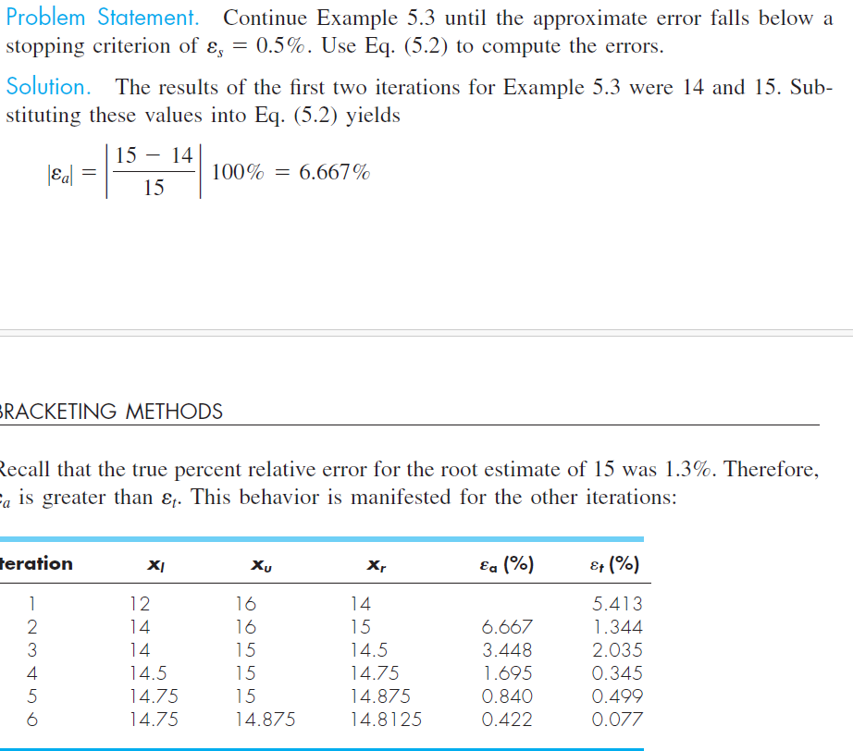
EXAMPLE 5.3 Bisection

Slide 11
Are iteration and bisection method for same problem ok
Yes, iteration method and bisection method can absolutely be used on the same problem, especially when the problem is to find a root of a nonlinear equation, like: f(x)=0

Slide 12
Introduction
Both Bisection and Iteration methods are used to find roots of nonlinear equations.
We compare their approach, convergence, and use on the same problem.
Example problem: Solve f(x) = x - cos(x) = 0

Slide 13
Bisection Method Overview
- Type: Bracketing method
- Requires interval [a, b] with f(a)*f(b) < 0
- Guaranteed convergence (slow)
- Divides interval in half at each step

Slide 14
Iteration Method Overview
- Type: Open method (Fixed-point)
- Rewrite f(x) = 0 as x = g(x)
- Converges if |g'(x)| < 1 near the root
- Faster than bisection (if convergent)

Slide 15
Solving x = cos(x)
Bisection Method:
- f(x) = x - cos(x)
- Choose [0, 1] where f(0)*f(1) < 0
Iteration Method:
- Use g(x) = cos(x)
- x₀ = 0.5 → x₁ = cos(0.5) → x₂ = cos(x₁) ...

Slide 16
Comparison: Bisection vs Iteration
Bisection Method:
- Always converges
- Slower (linear convergence)
- Needs interval with sign change
Iteration Method:
- May not converge
- Faster (if converges)
- Needs good initial guess

Slide 17
Conclusion
- Both methods solve f(x) = 0
- Bisection: Safe and slow
- Iteration: Fast but sensitive
- Choose based on problem nature and available data

